Slide 1
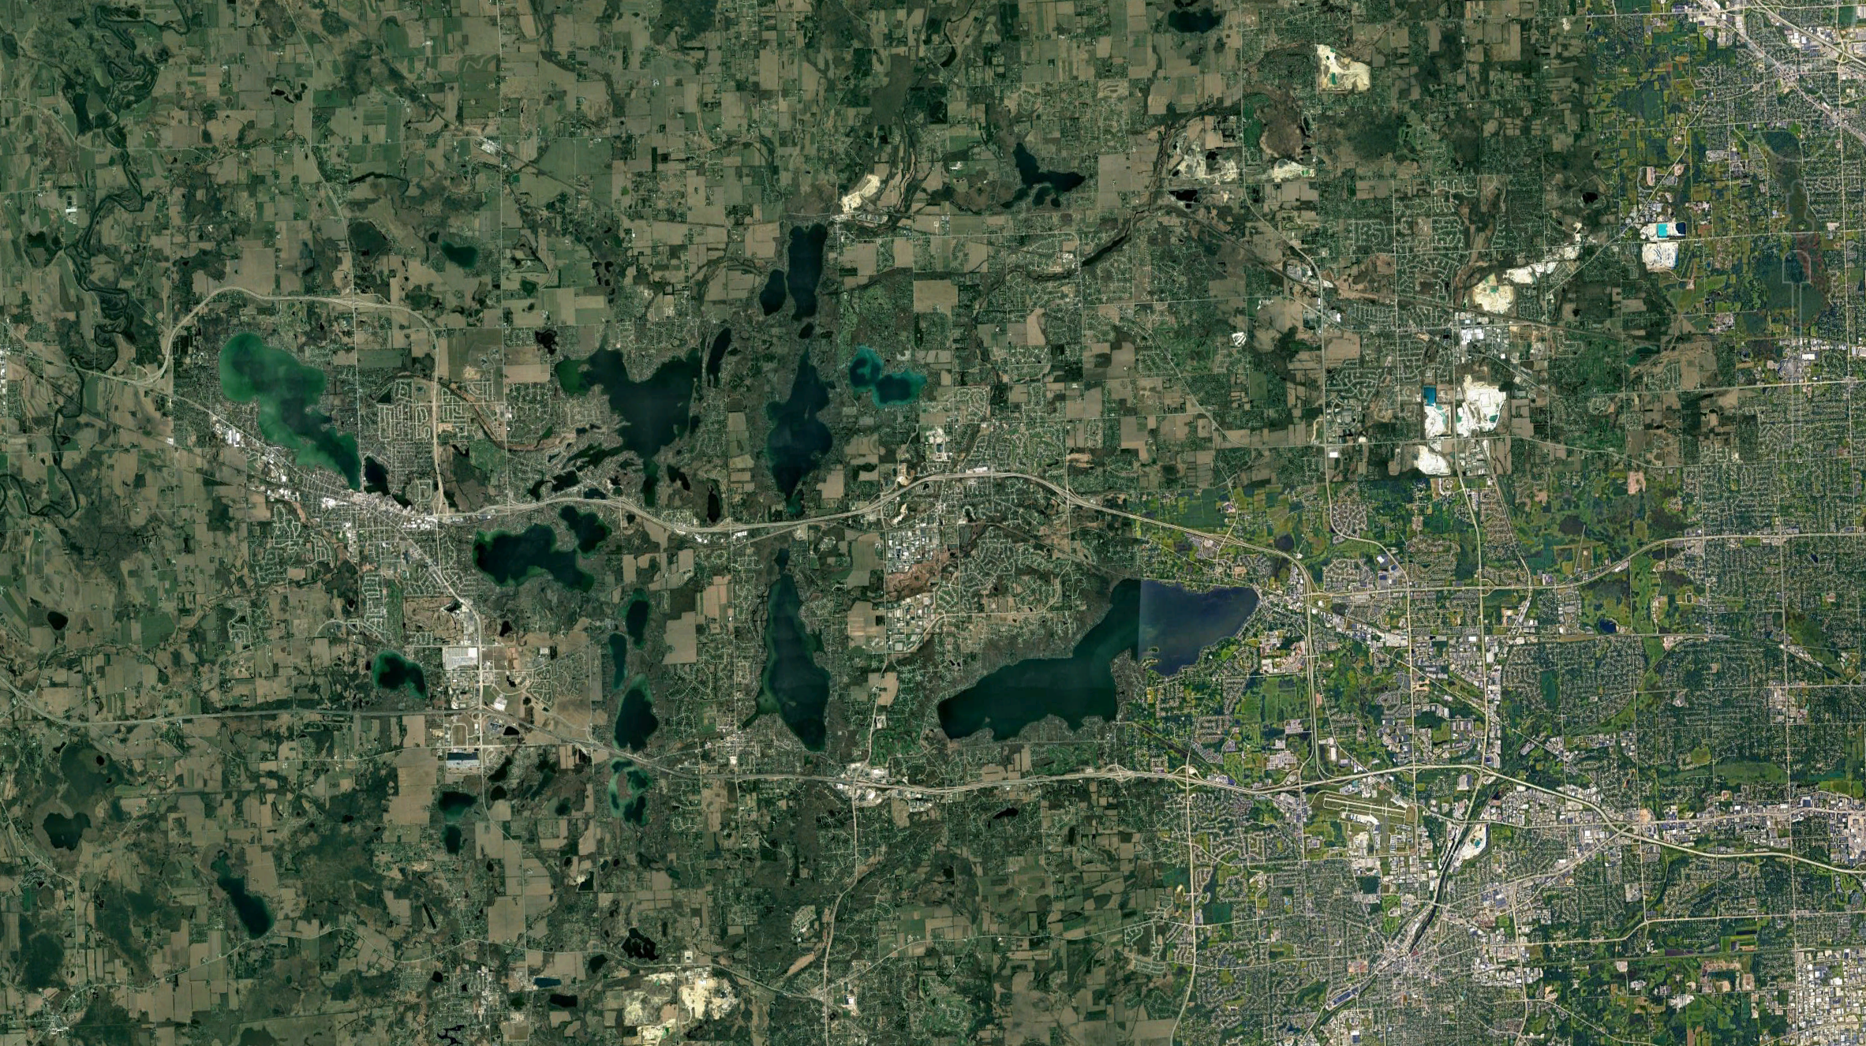


Ecological memory of climate and land use change shapes water quality across >650 widespread lakes
Abigail Lewis, Wei Zhi, Juliane Mai, Nandita Basu, Cayelan Carey
Notes:
7 minutes for presentations (2 min for Q&A)1 - SO SHORT! Presentation Length: 08:39 – 08:48 PST
Hi my name is Abby Lewis and I’m excited to talk about a couple of projects I have been leading that are focused on ecological memory of climate and land use change across widespread lakes.

Slide 2
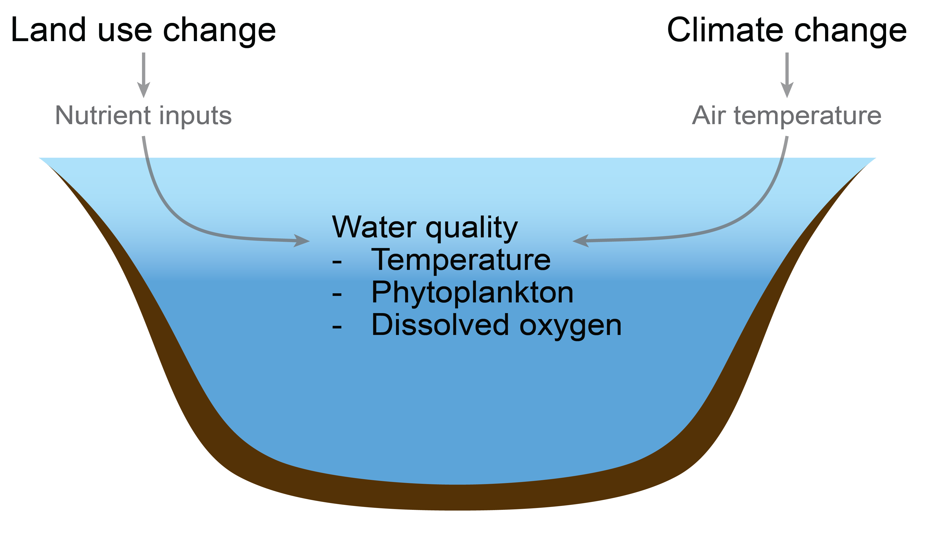

Ecological memory of climate and land use may shape water quality over multiple timescales
Ecological memory
seasons → decades
Notes:
Both climate and land use can have substantial effects on in-lake water quality, but analyzing and comparing the relative influence of these drivers is made much harder by legacies of historical impacts. “Ecological memory” effects occur over multiple timescales, from within-year legacies of winter and spring dynamics that persist throughout the summer to multi-decadal legacies of nutrient loading that continue to cause water quality concerns across widespread lakes.

Slide 3
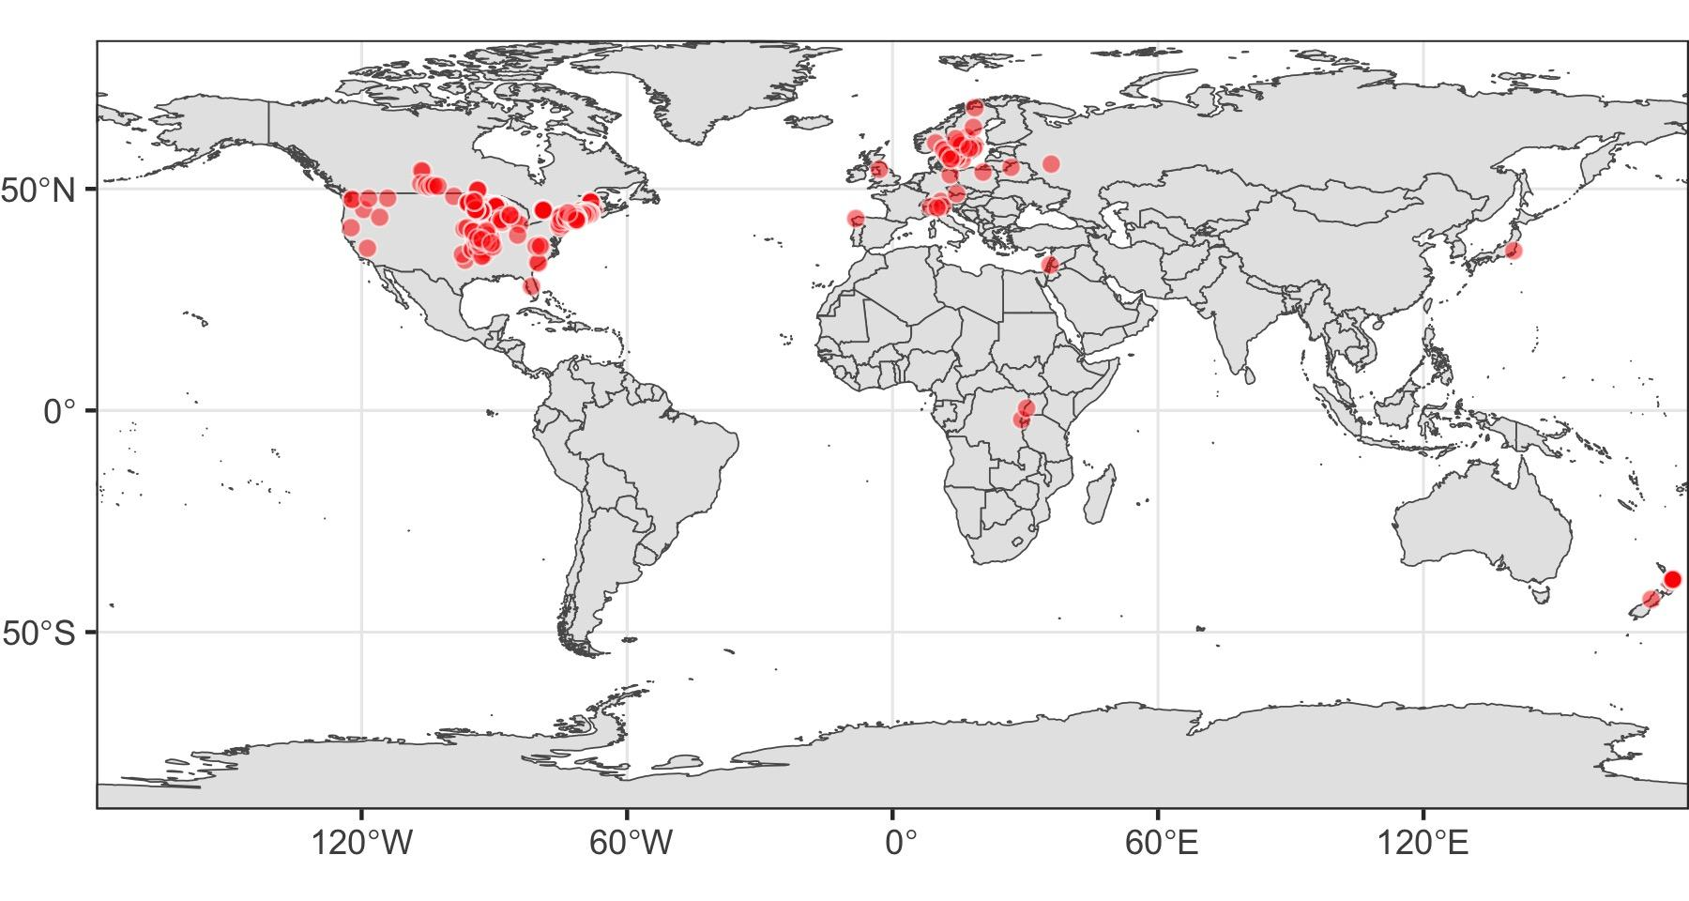
We synthesized data from >650 lakes to characterize memory effects of both climate and land use
Temperate stratified lakes in 18 countries
Median of 30 years of data at each lake
Lewis et al. 2024 GCB
Notes:
In this study we used a database of over 650 lakes around the world to characterize ecological memory effects of climate and land use change.

Slide 4
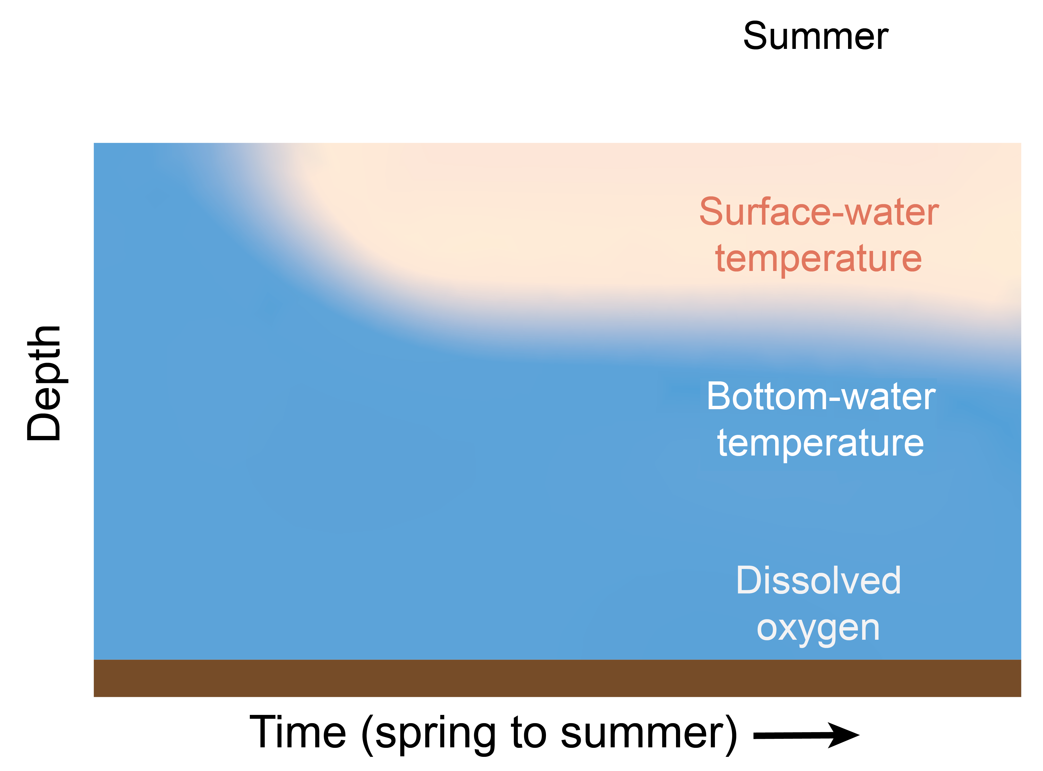
Ecological memory of seasonal air temperature change
Climate
Notes:
Add box on figure on left
Break apart spring and summer, add parallel arrows

Slide 5
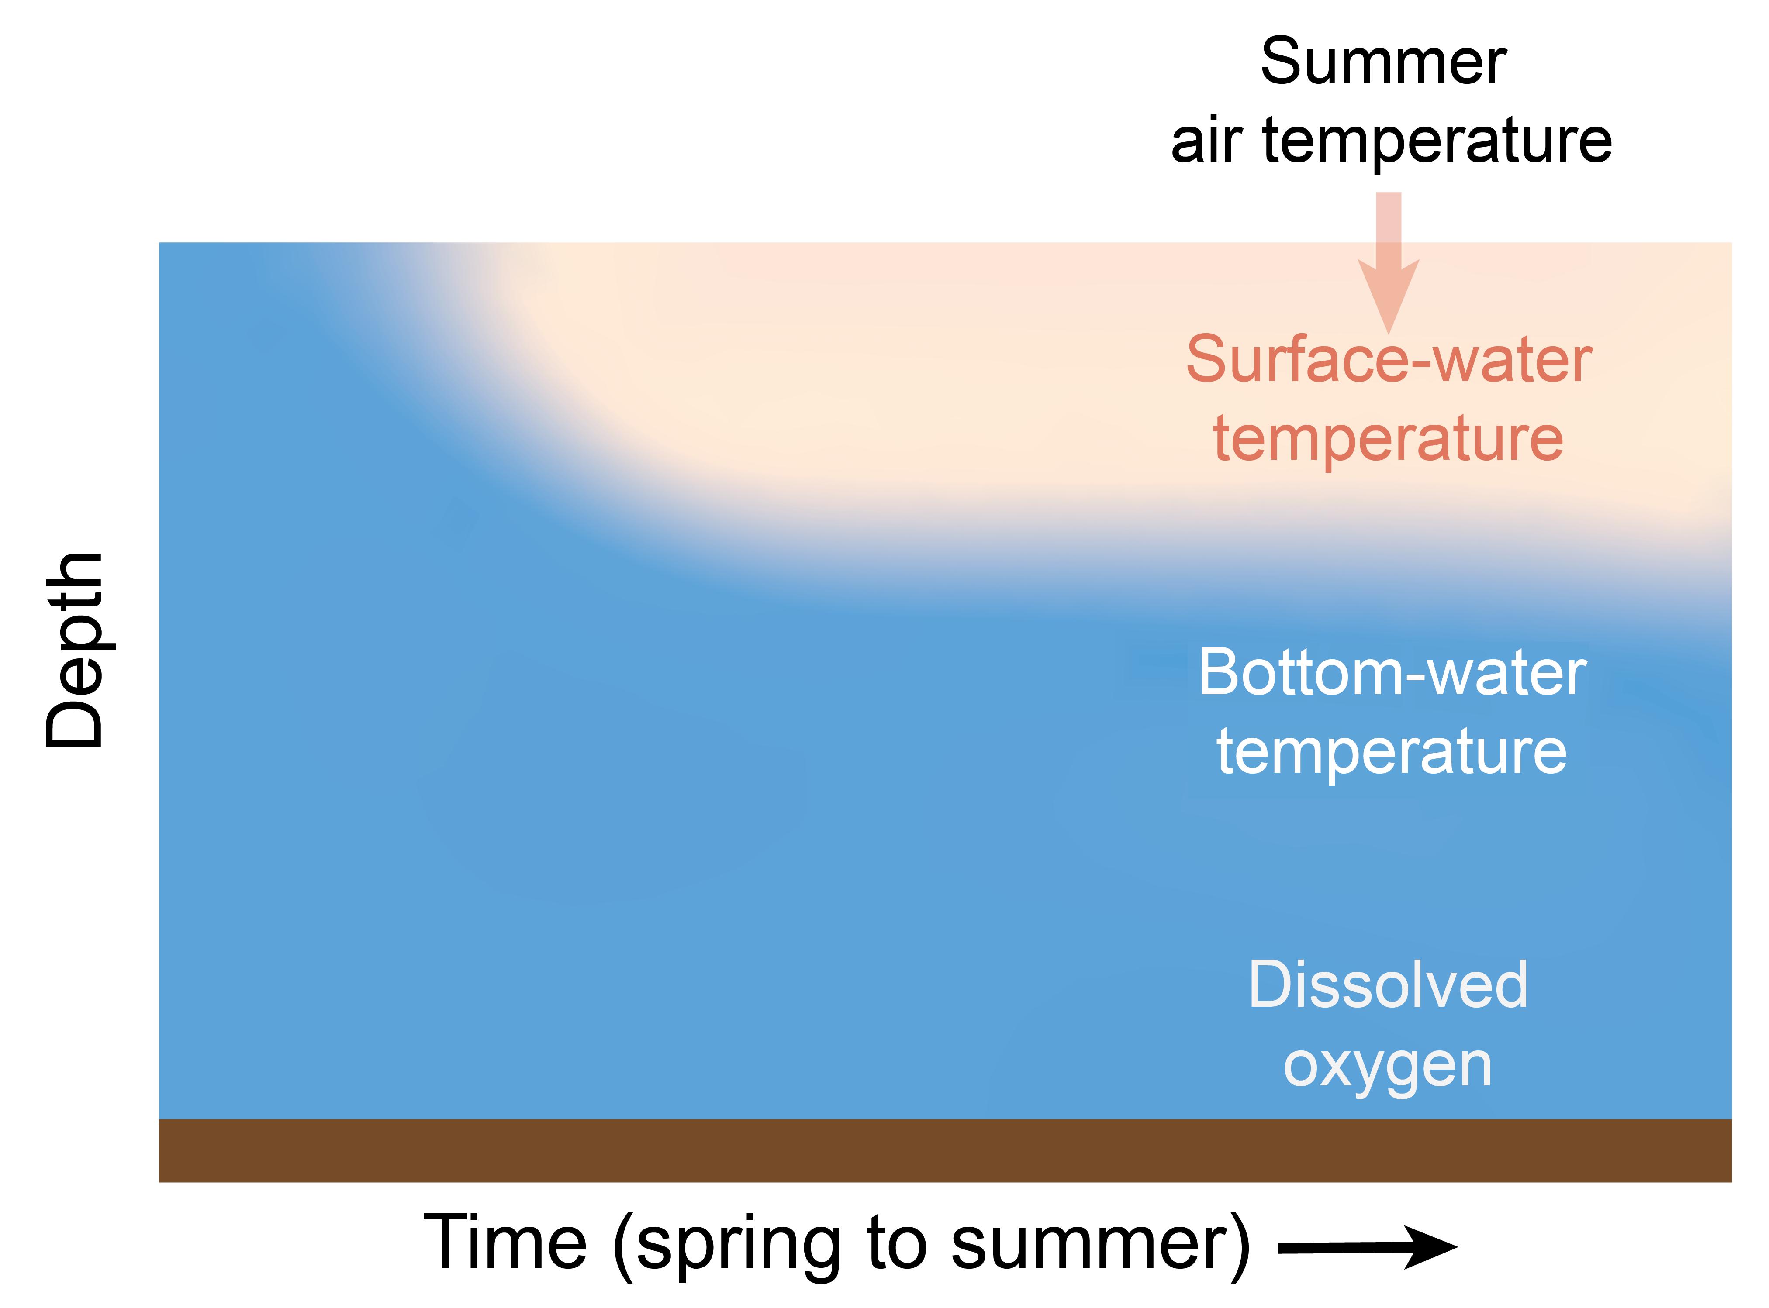
Ecological memory of seasonal air temperature change
Climate
Notes:
Add box on figure on left
Break apart spring and summer, add parallel arrows

Slide 6
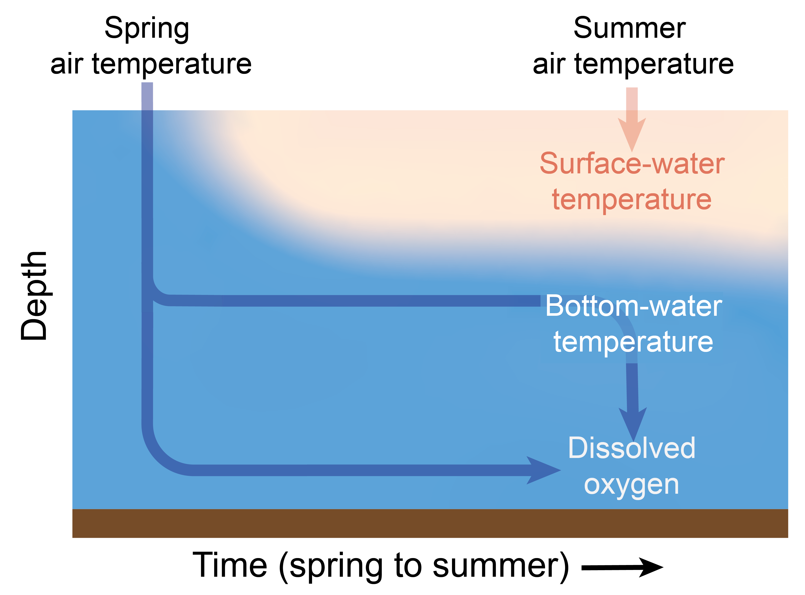
Ecological memory of seasonal air temperature change
Climate
Notes:
Add box on figure on left
Break apart spring and summer, add parallel arrows

Slide 7
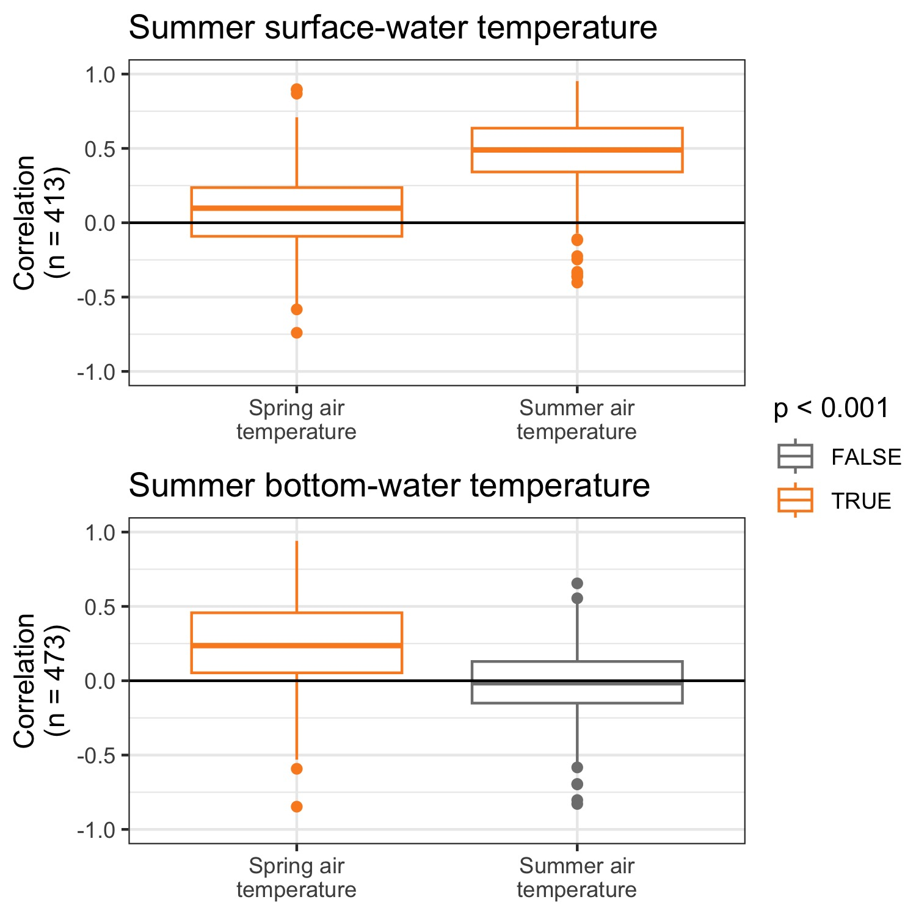
Summer surface-water temperature is correlated with summer air temperature
Climate
Conversely, summer bottom-water temperature is correlated with spring air temperature
Notes:
Add box on figure on left
Break apart spring and summer, add parallel arrows

Slide 8
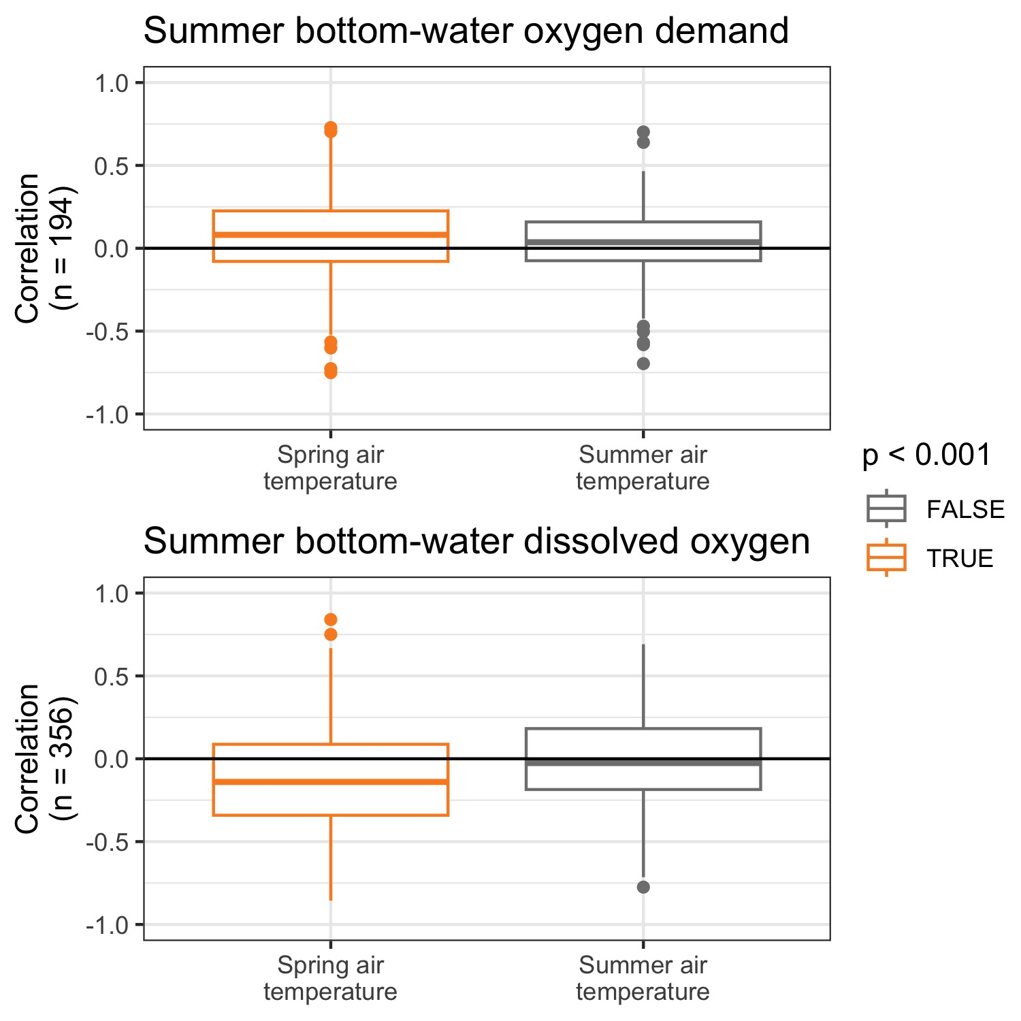
Ecological memory of spring air temperatures controls summer bottom-water oxygen dynamics
Climate

Slide 9
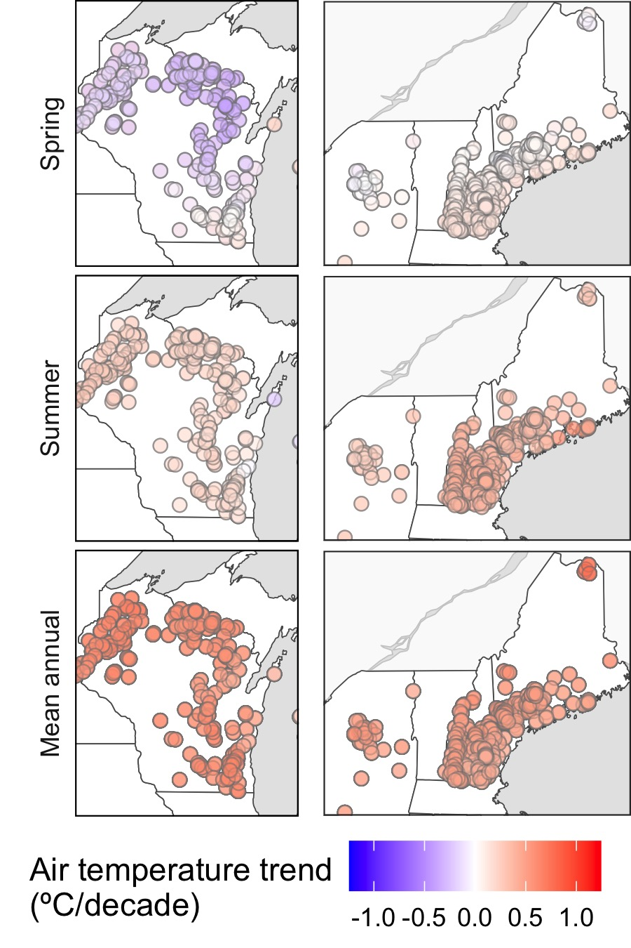
Intra-annual ecological memory is particularly important due to seasonally heterogeneous air temperature change
1980–2022
Climate

Slide 10
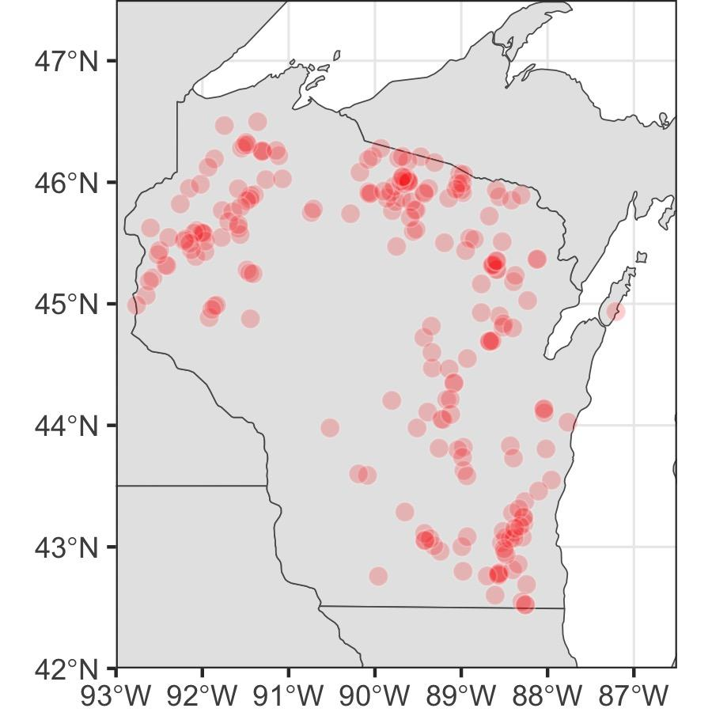
Nutrient inputs could be directly correlated with in-lake concentrations, or may exhibit legacy effects
Land use
Notes:
Next up in our whirlwind tour of ecological memory in lakes, I’m going to talk a little bit about land use. This analysis is in pretty early phases, and has been a really exciting collaboration with Nandita Basu, Juliane Mai, and Wei Zhi. To characterize ecological memory of nutrient loading, we zoomed in to the state of Wisconsin, which is an area of particularly high data availability in our study and allows us to partially isolate the effects of land use independent of broad differences in climate dynamics.

Slide 11





TP inputs were modeled for each lake using climate and land use data
Land use
Streamflow model
Climate driver data
Modeled streamflow
TP
Dr. Juliane Mai
University of Waterloo
Dr. Wei Zhi
University of Waterloo
Now: Hohai University
Phosphorus model
TP input timeseries
Phosphorus timeseries data (land use, wastewater)

Slide 12
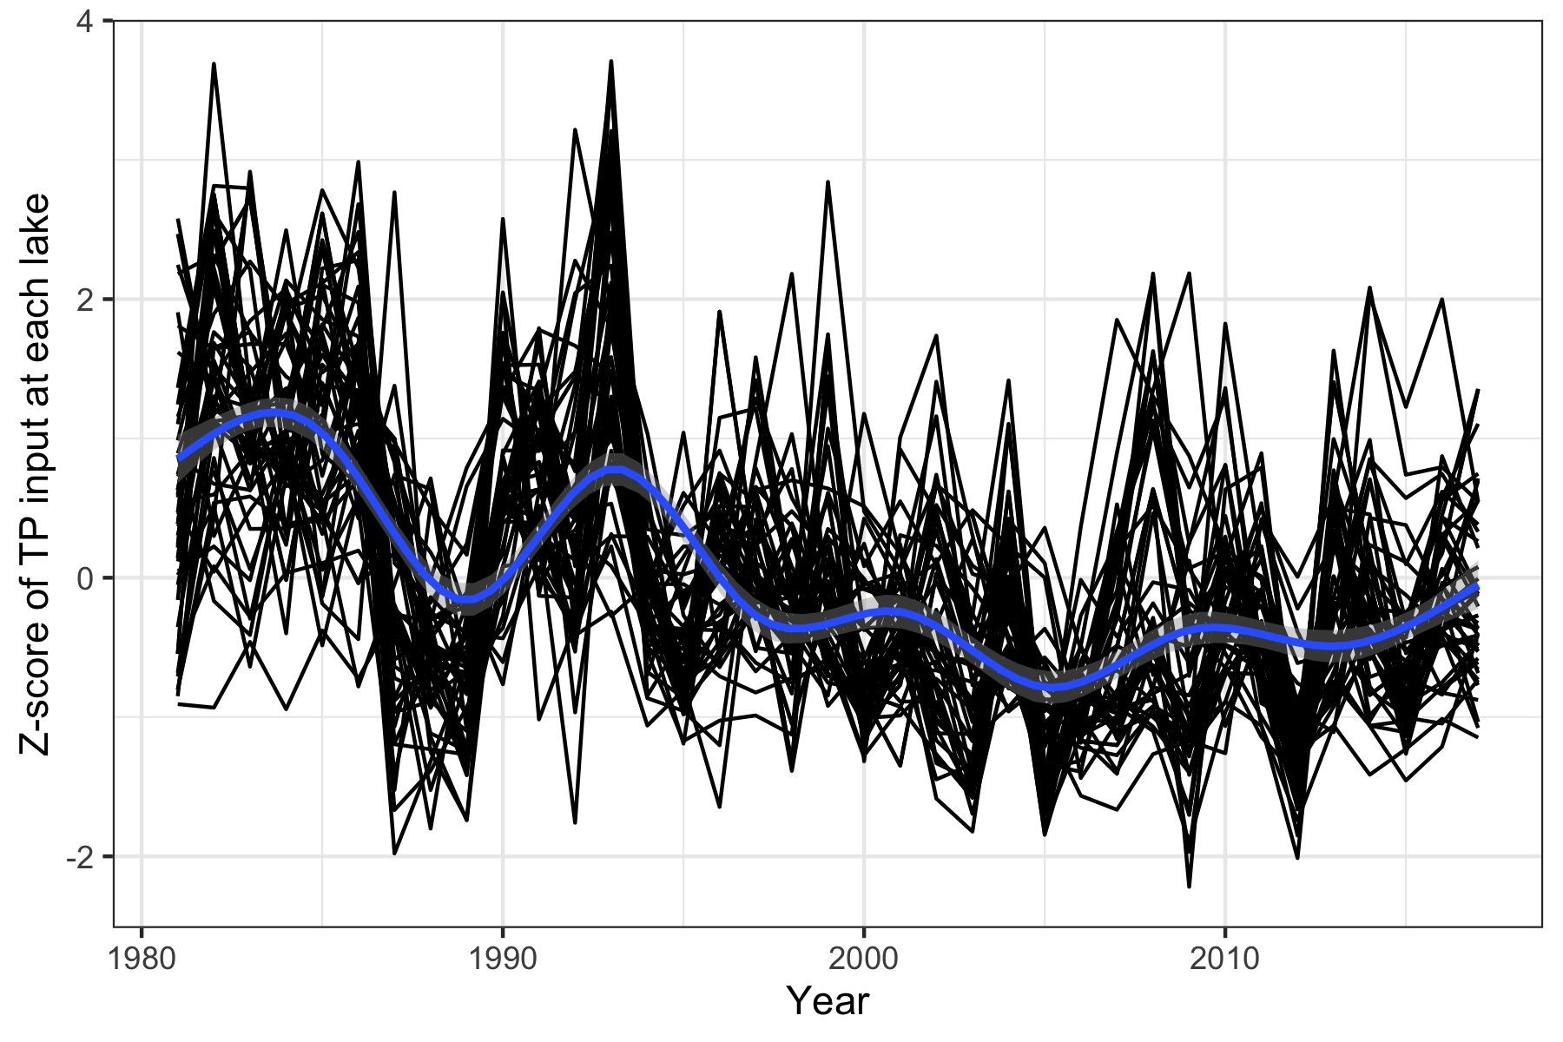
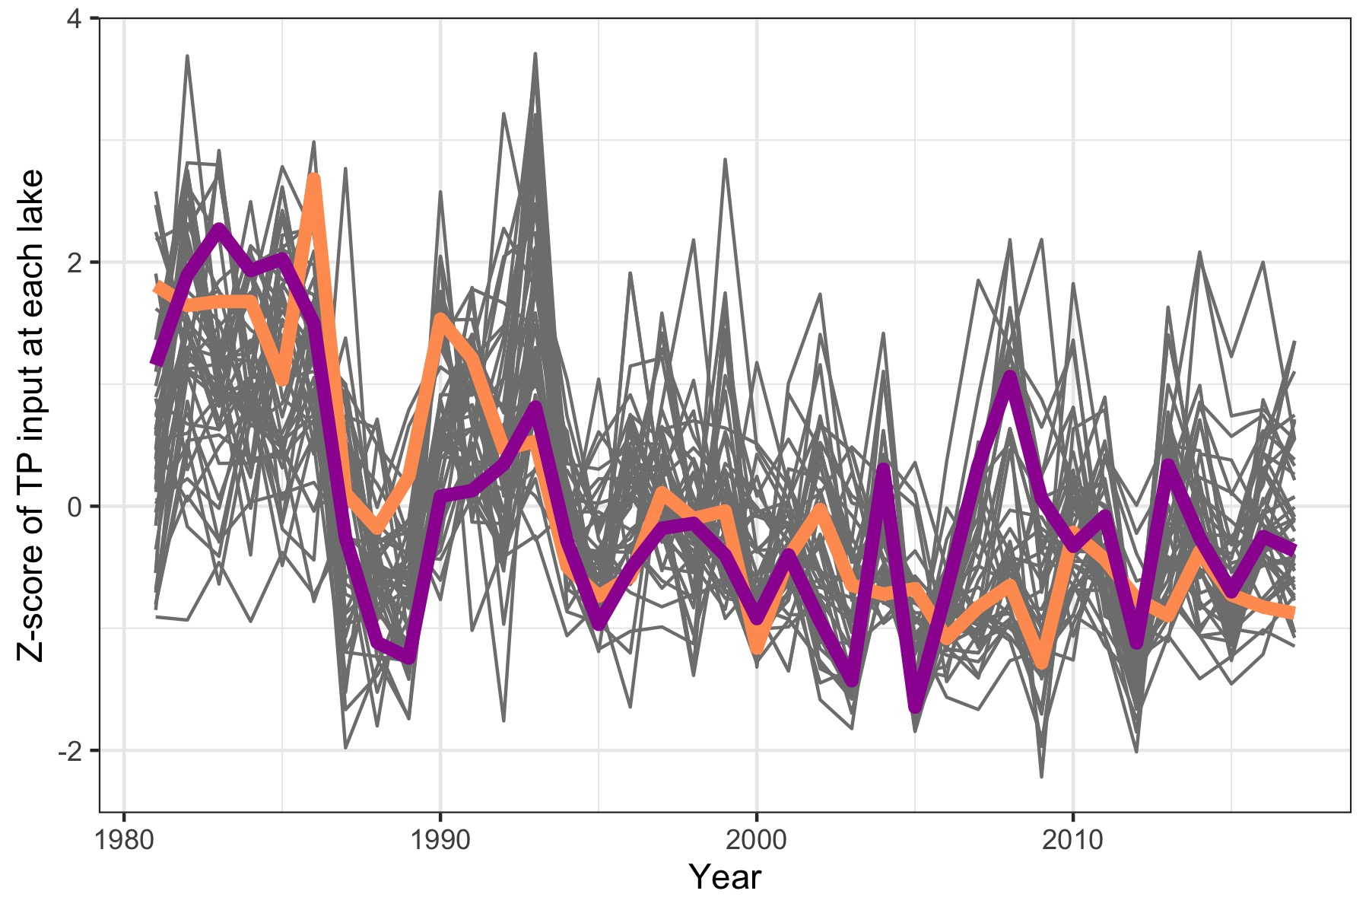
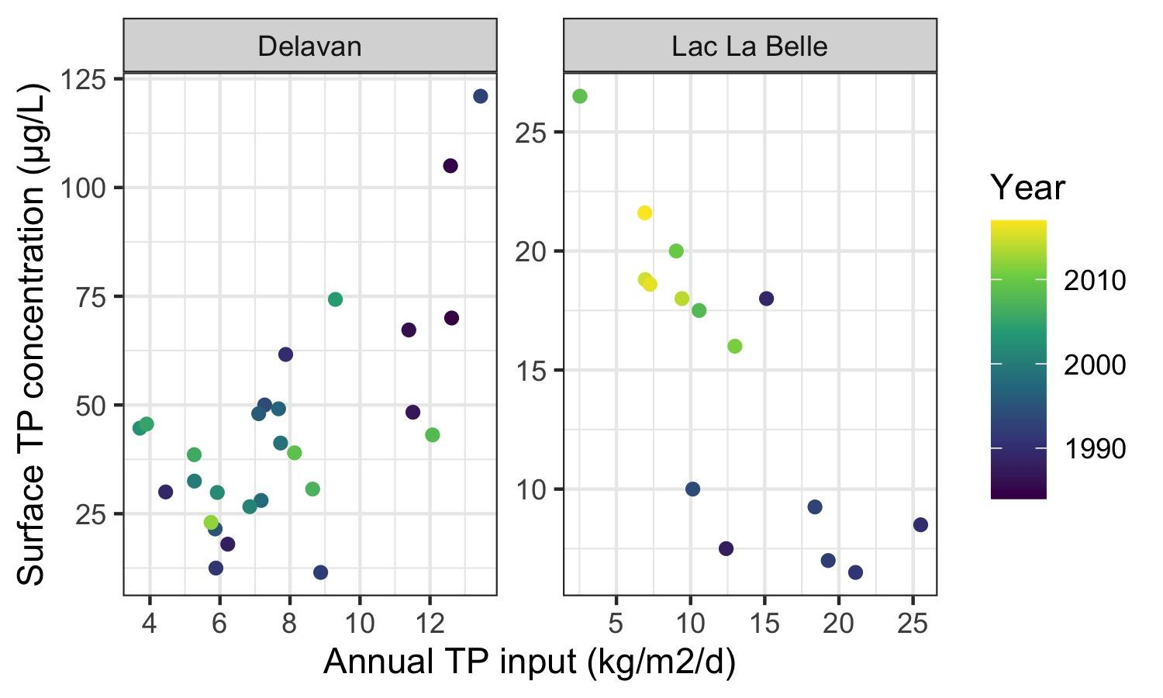
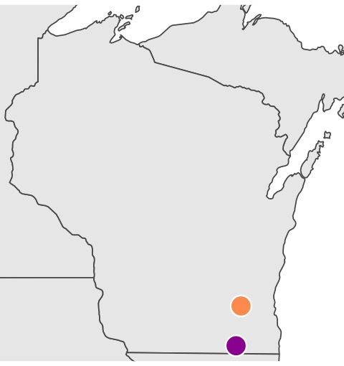
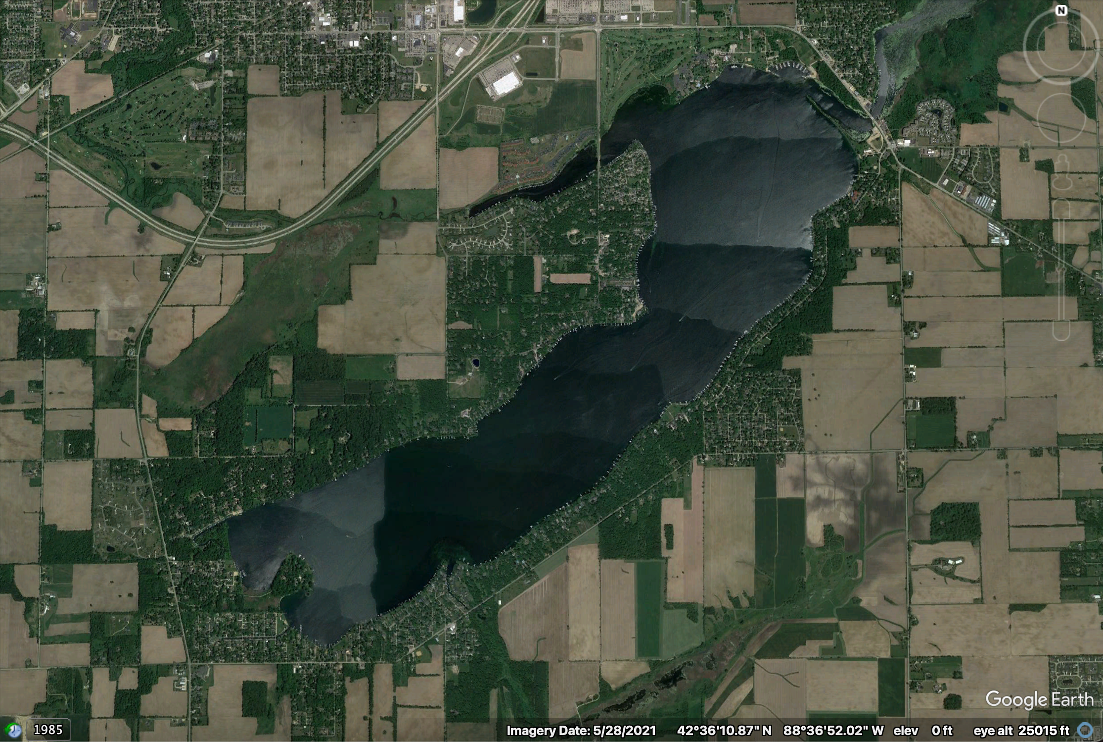
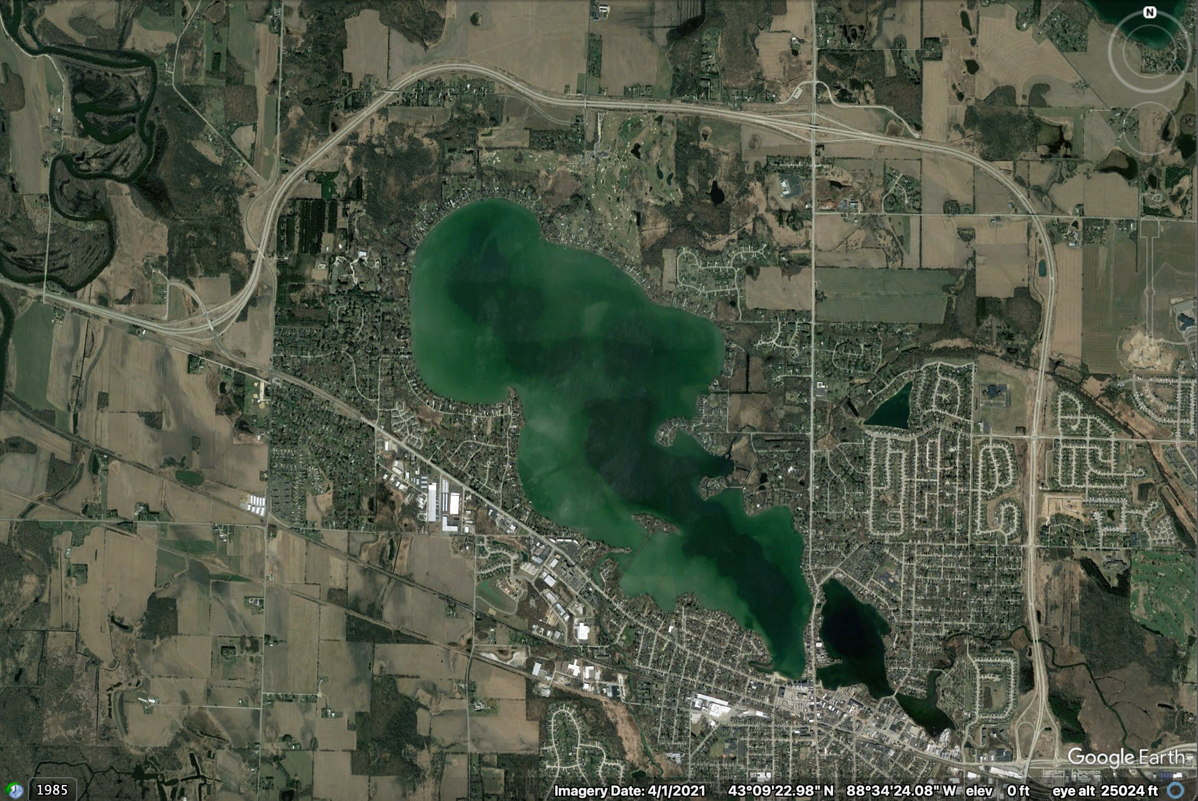
Preliminary results suggest legacy effects of nutrient loading in some Wisconsin lakes
Land use
Divergent patterns of in-lake responses
Delavan
Lac La Belle
Across lakes, TP inputs tended to decrease from ca. 1980–2000, then stabilize
Notes:
Don’t have time to talk about all lakes, so I’m going to tell the story of two lakes.
Talk about spring temp in these two lakes
Both lakes have hypo temps positively correlated with April air temps
Outline the lakes
Bonus slide with same limits

Slide 13
Next steps
What lake or catchment characteristics determine the strength of ecological memory for air temperatures and nutrient inputs?
What is the relative importance of climate and land use in shaping water quality?
Notes:
Short script here

Slide 14
Ecological memory shapes water quality dynamics, both within and across years
Spring air temperature is a key determinant of summer bottom-water temperature and dissolved oxygen
Effects of nutrient loading are difficult to identify within and across lakes, potentially due to ecological memory effects

Slide 15








Many thanks to collaborators, data contributors, and funding sources for enabling this work!

Slide 16



aslewis@vt.edu
@lewis_lakes
@aslewis.bsky.social
Notes:
Add email address, etc

